Slide 1
Project Check-in
Alex Mueggenberg and Sebastian Rios

Slide 2
Agenda
Quick Look into graphs regarding Univariate, Bivariate, and Visualization graphs.
Next, taking a look into a T-test
Data Dictionary
Then, showing future questions regarding where we would like to take the project
Lastly, an outline of our road map

Slide 3
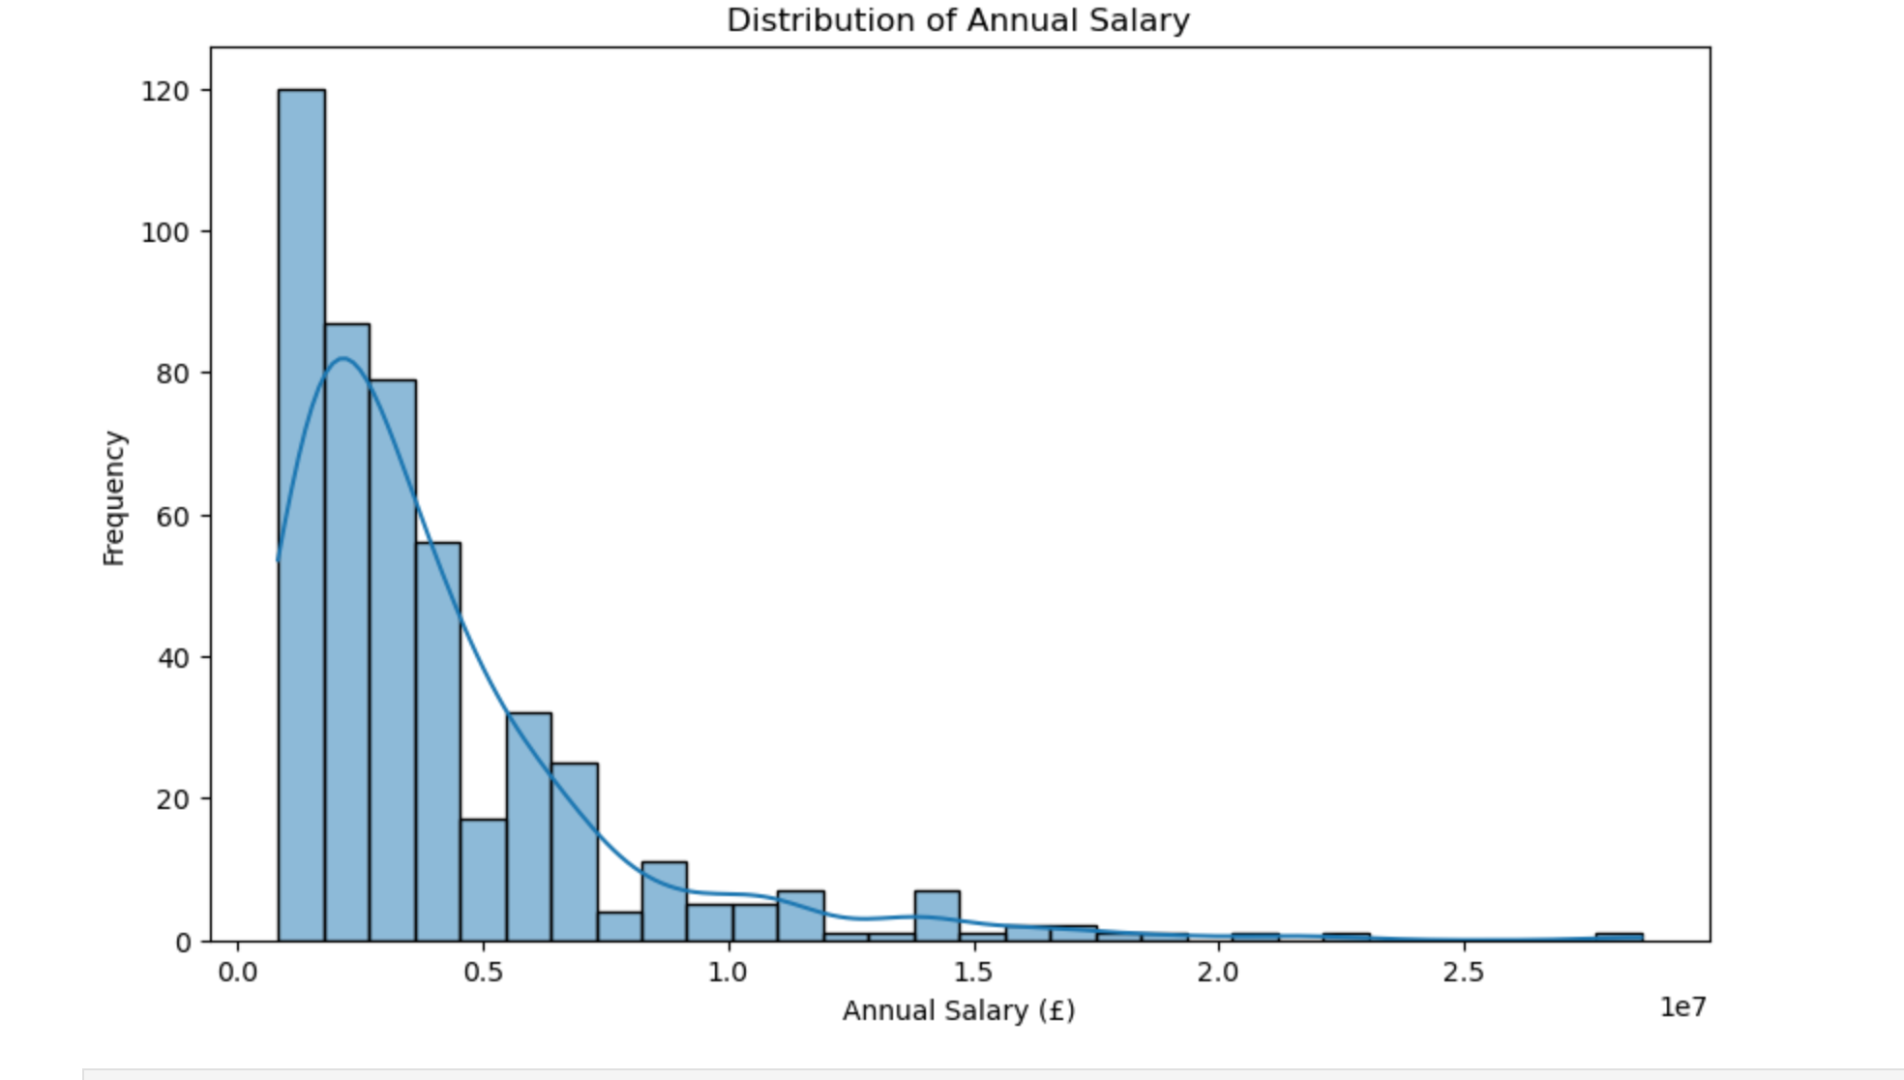
Initial Findings: Univariate Analysis
Distribution of Annual Salary
Shows a right-skewed distribution.
Most players earn lower annual salaries, with fewer players earning extremely high salaries.
Salary range extends up to around £27 million.
A few outliers with very high salaries pull the distribution's tail to the right.

Slide 4
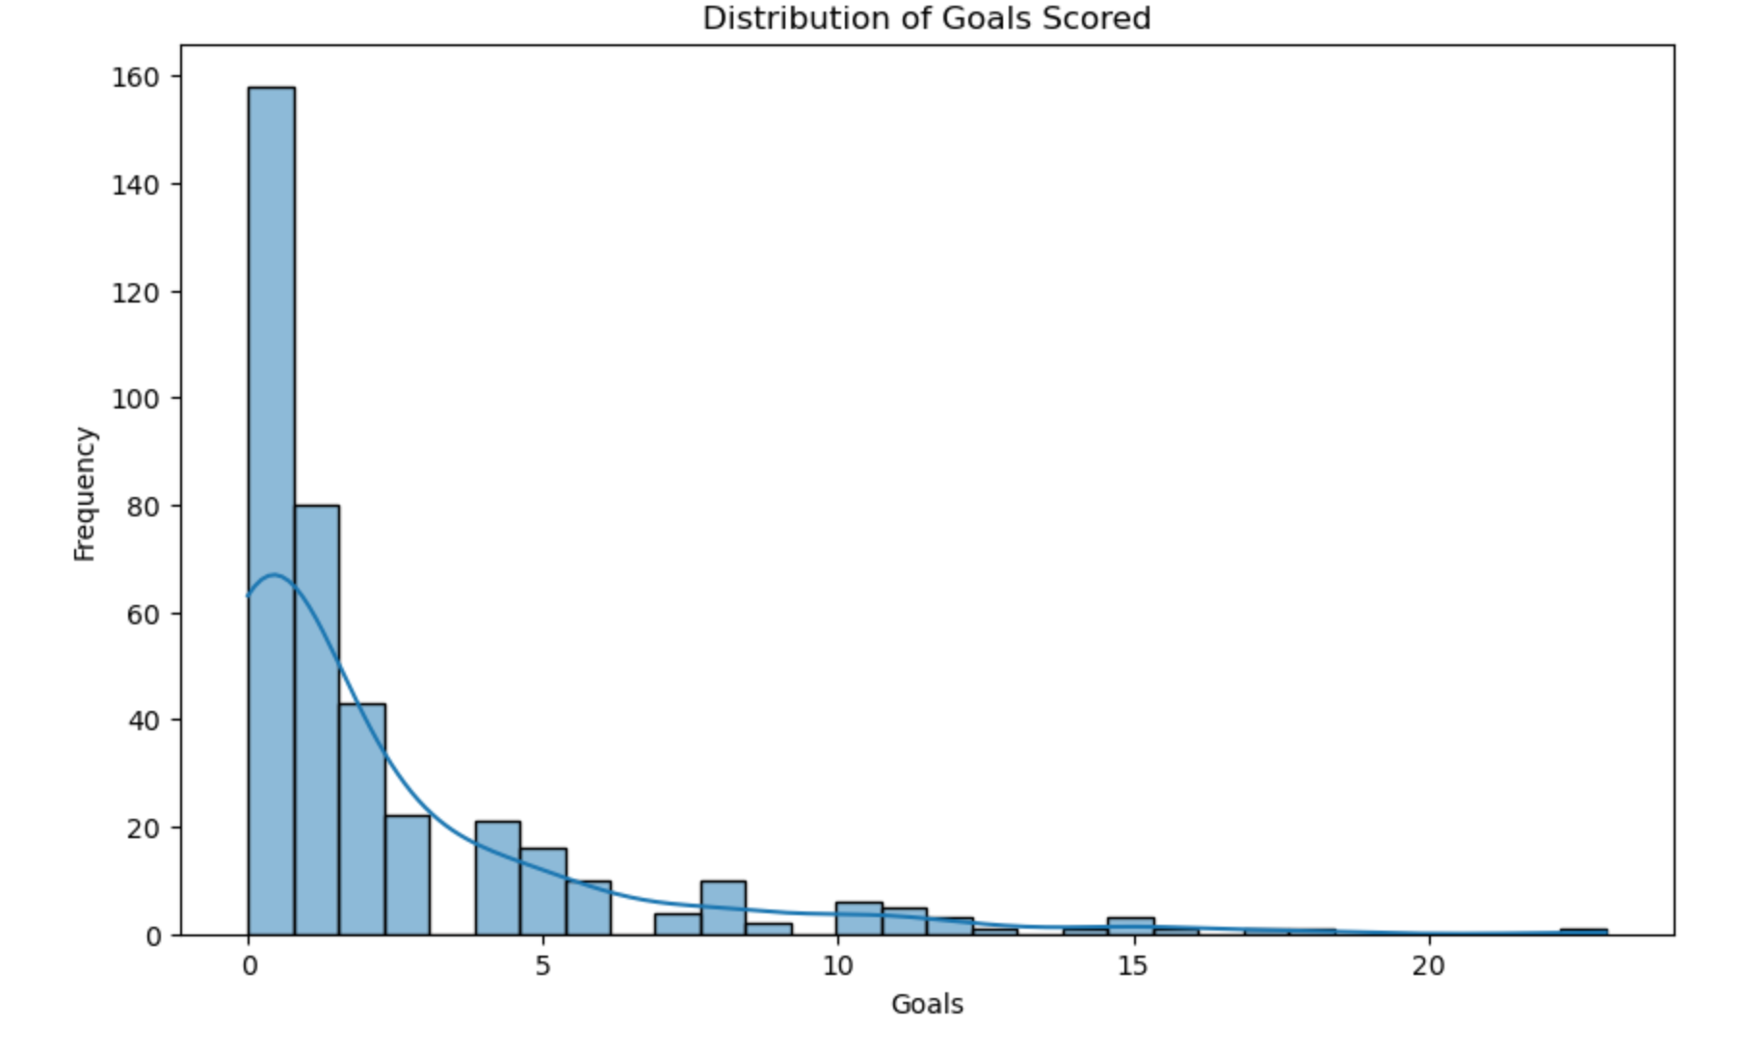
More Univariate Analysis
Distribution of Goals Scored
Also a right-skewed distribution, similar to salary.
Most players scored very few goals, with 0–2 goals being the most common.
A small number of players scored higher (up to 20+ goals), but they are rare.
Indicates that high goal scorers are relatively uncommon.

Slide 5
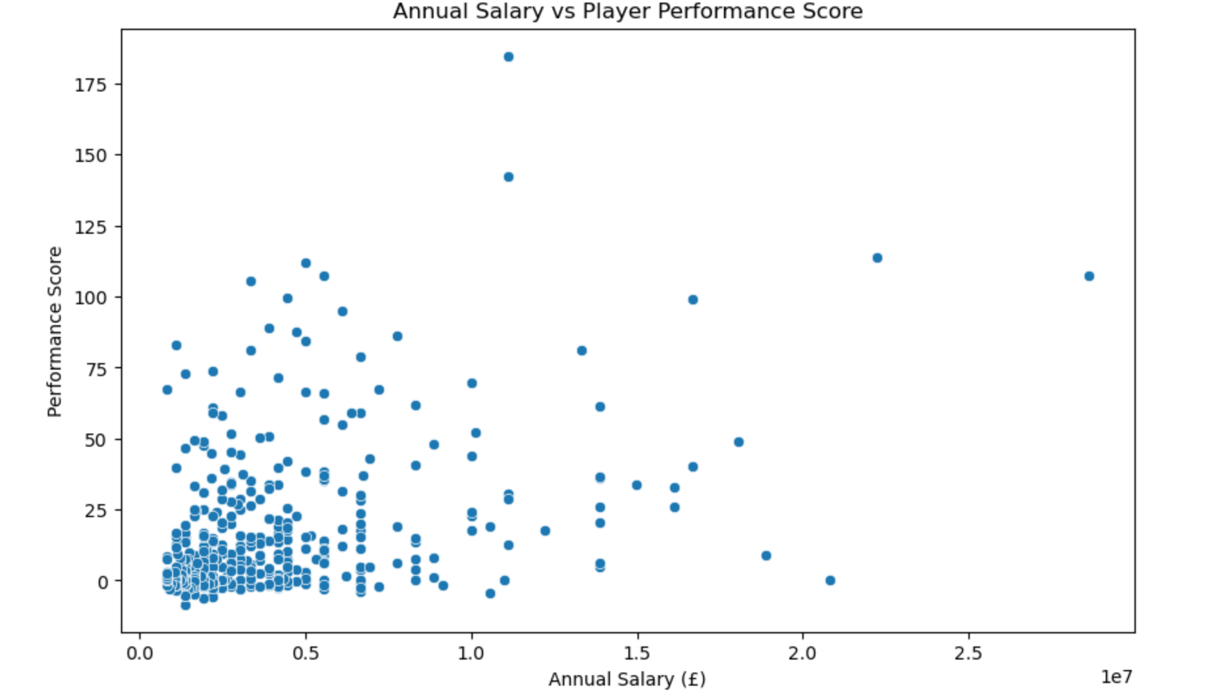
Bivariate Analysis
Annual Salary vs Player Performance Score
No strong linear relationship between salary and performance score.
Players with lower salaries are highly clustered around lower performance scores.
Some high earners have both high and low performance scores.
A few outliers show players with moderate salaries achieving very high performance scores.

Slide 6
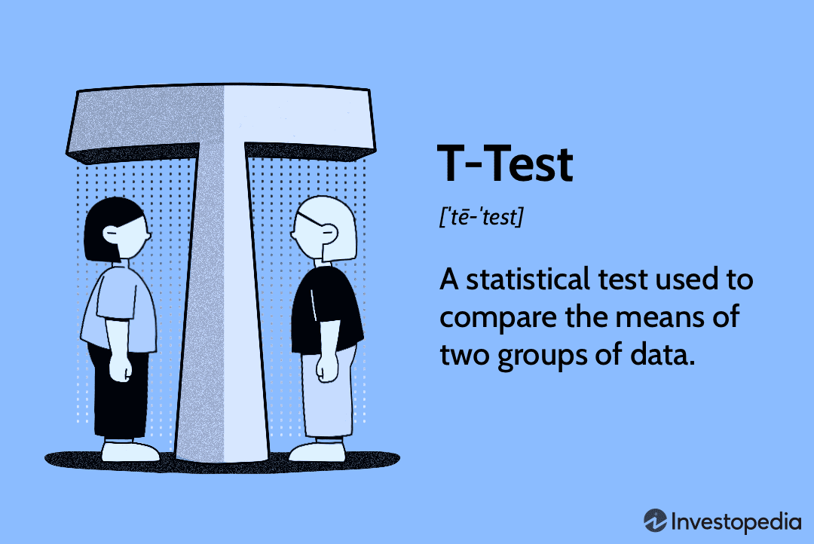
T-Test: Salary vs. Goals
Null Hypothesis (H0): Players who earn above the median salary do not score more goals than those earning below the median salary.
Alternative Hypothesis (H1): Players who earn above the median salary score more goals than those earning below the median salary
Question: Do players who make above-median salary score more goals than those below?
T-statistic: 4.883327878093698
P-value: 1.5289008613138267e-06
Reject the null hypothesis: Players earning above the median salary score significantly more goals.

Slide 7
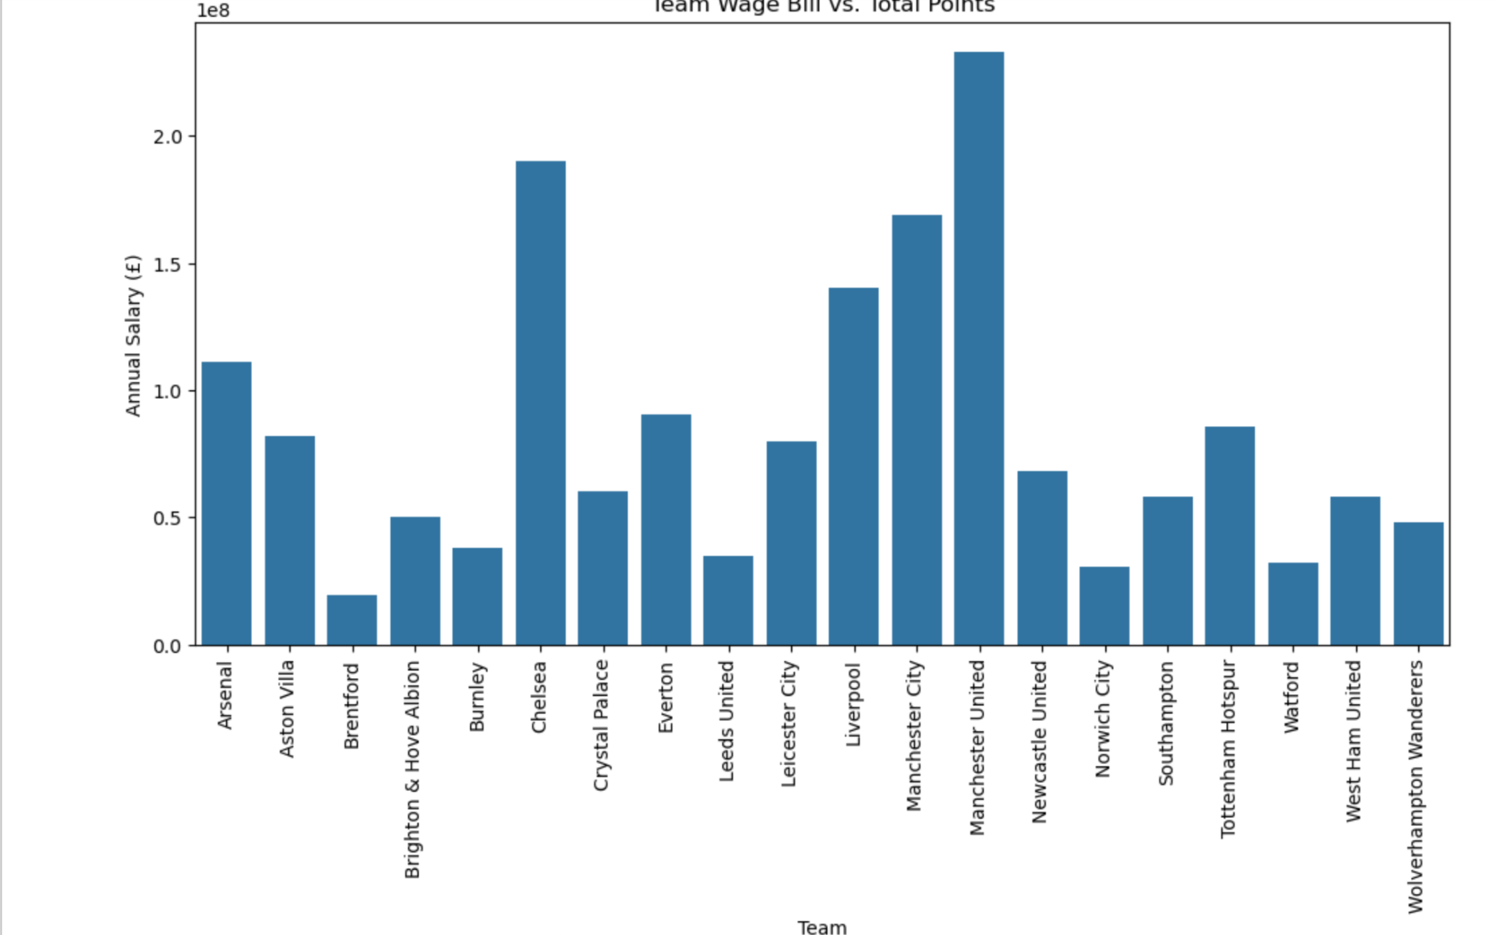
Visualization
Team Wage Bill vs Total Points
The bar plot displays the teams and the sum of money each player costs combined with total points per team
Bar plot suggests two peaks within the teams, Manchester United and Chelsea.
Average cost per team is Є83,990,038.5
Manchester city with the third highest peak had won the league during the 2021-2022 season

Slide 8
Data Dictionary
Column Description
Player Name of the player.
Weekly Salary Player's weekly salary (£).
Annual Salary Player's annual salary (£).
Position General position category (e.g., Forward, Midfielder, Defender, Goalkeeper).
Team Club or team the player belongs to.
Nation Player's nationality.
Pos Specific playing position (e.g., ST, CM, CB, GK).
Age Player's age.
MP Matches played.
Points Total points earned by the team (3 for a win, 1 for a draw).
Performance Score Custom overall player/team performance metric (depending on your definition).
Column Description
Starts Matches started (as part of starting lineup).
Min Total minutes played.
90s Number of full 90-minute games played (Min ÷ 90).
Gls Goals scored.
Ast Assists made.
G-PK Goals scored excluding penalties.
PK Penalty goals scored.
PKatt Penalty attempts (both scored and missed).
CrdY Yellow cards received.
Goal Difference Goal differential (Goals For - Goals Against).
Column Description
CrdR Red cards received.
Gls.1 Goals per 90 minutes.
Ast.1 Assists per 90 minutes.
G+A Combined goals and assists.
G-PK.1 Non-penalty goals per 90 minutes.
G+A-PK Combined non-penalty goals and assists.
xG Expected goals (xG) — model-estimated quality of chances.
npxG Expected goals excluding penalties (non-penalty xG).
xA Expected assists (xA) — model-estimated assists based on chance quality.
Goals Against Total goals conceded by the team.
Column Description
npxG+xA Sum of non-penalty expected goals and expected assists.
xG.1 Expected goals per 90 minutes.
xA.1 Expected assists per 90 minutes.
xG+xA Sum of xG and xA per 90 minutes.
npxG.1 Non-penalty expected goals per 90 minutes.
npxG+xA.1 Sum of non-penalty expected goals and expected assists per 90 minutes.
Played Number of matches the team played.
Won Number of matches won by the team.
Drawn Number of matches drawn by the team.
Lost Number of matches lost by the team.
Goals For Total goals scored by the team.

Slide 9

Questions
Who offers the best value?
Are player positions over/underpaid?
How does playing time impact player performance relative to salary?

Slide 10
Road Map
Shortening of the data
Continue looking into analysis, continue with other variables
Shortening of amount of players
Clean up notebook and code
More machine learning
Overall further in-depth analysis

